Slide 1
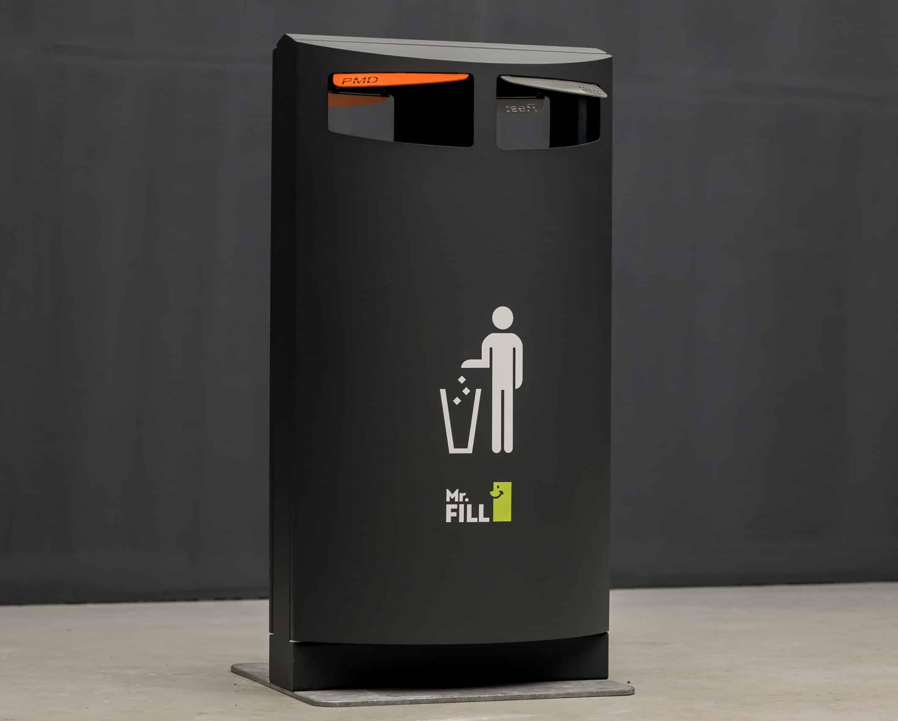
Smart BIN: AI-DRIVEN WASTE SORTING
BULAYA MWANAUTE​

Slide 2
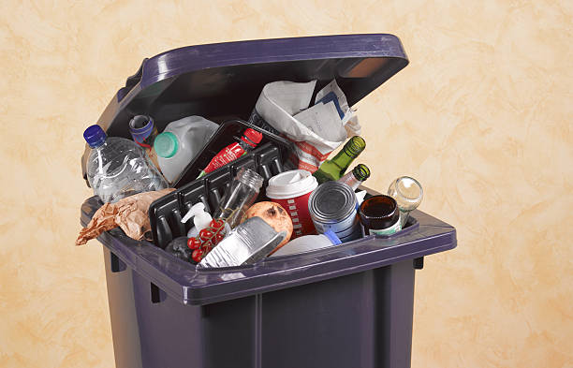

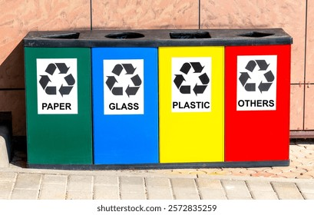
Introduction
Improper waste disposal leads to severe environmental and health hazards.
In Zambia, waste collection rates are low, and sorting is almost non-existent, contributing to pollution and inefficiency.
Introducing the Smart Bin: an AI-powered solution that sorts waste automatically, reducing human effort and increasing recycling efficiency.

Slide 3

Problem STATEMENT
statistic
challenges
Lusaka generates approximately 1,200 tonnes of waste daily, but only half is collected properly.
Low access to formal waste collection services.
Illegal dumping and open-air burning are common.
Lack of proper waste segregation at disposal points.

Slide 4
Current Waste Sorting Methods:
Existing solutions & their limitations
Limitations:
Manual Sorting: Labor-intensive, hazardous, and inefficient.
Automated Sorting: Optical sensors, air classifiers, but expensive.
Eddy Current Separators: Work only for metals, but costly and require infrastructure.
High operational costs.
Limited accessibility for small-scale use.
Cannot handle mixed or contaminated waste efficiently.

Slide 5




Proposed solution – the smart bin
A Smart Bin that autonomously identifies and sorts waste into recyclable and non-recyclable categories using AI.
Unique
First to market
Tested
Authentic
Automated sorting mechanisms for proper disposal
First beautifully designed product that's both stylish and functional
AI image recognition for waste classification

Slide 6

Product benefits
Simple and efficient to use​
Quick customer service assistance​
Free 90-day trial for new customers​​

Slide 7

Company overview

Slide 8

Business Model
Research​
We based our research on market trends and software sales ​
Abstract​
We believe people need new management tools to help businesses achieve their OKRs​
Design​
Minimalist design and easy to use ​

Slide 9
Market overview
$3B
$2B
$1B
Opportunity to build​
Fully inclusive market​
Total addressable market​
Freedom to invent​
Selectively inclusive market​
Serviceable available market​
​
Few competitors​
Specifically targeted market​
Serviceable obtainable market​
​

Slide 10

Market Comparison
Opportunity to build​
Fully inclusive market​
Total addressable market​
Freedom to invent​
Selectively inclusive market​
Serviceable available market​
​
Few competitors​
Specifically targeted market​
Serviceable obtainable market​
​

Slide 11

Our competition
Contoso​
Competitors​
Our product is priced below that of other task management tools on the market​
Simple and easy to use app and website, compared to the complex tools of our competitors​
Affordability is the main draw for our consumers to our product​
Company A​ Product is more expensive​
Companies B & C ​ Product is expensive and inconvenient to use​
Companies D & E​ Product is affordable, but inconvenient to use

Slide 12
competition
Convenient
Contoso
A
Expensive​
Affordable
B
D
E
C
Inconvenient​

Slide 13
Growth strategy
How we’ll scale in the future​
Feb 20xx
May 20xx
Oct 20xx
Distribute the app to local start ups to help establish the product
Release the app to the general public and monitor press and regional market trends
Gather feedback from the start up community to expand availability of the product

Slide 14
Two-year action plan
Supply volunteers​
Run focus groups​
Gather feedback​
20XX
Jan
Feb
Mar
Apr
May
Jun
Jul
Aug
Sep
Oct
Nov
Dec
Test with start ups​
Regional launch​
Deliver to consumers​
20XX
Jan
Feb
Mar
Apr
May
Jun
Jul
Aug
Sep
Oct
Nov
Dec

Slide 15

Financials
 | Year 1 | Year 2 | year 3
Detailers​ | 5,000​ | 40,000​ | 160,000​ | ​
Users​ | 50,000​ | 400,000​ | 1,600,000​ | ​
Sales​ | 500,000​ | 4,000,000​ | 16,000,000​ | ​
Average Price per Sale​ | 75​ | 80​ | 90​ | ​
Revenue @ 15%​ | 5,625,000​ | 48,000,000​ | 216,000,000​ | ​
Gross Profit​ | 5,625,000​ | 48,000,000​ | 216,000,000​ | ​
Expenses​ | ​ | ​ | ​ | ​
Sales & Marketing​ | 5,062,500​ | 38,400,000​ | 151,200,000​ | ​
Customer Service​ | 1,687,500​ | 9,600,000​ | 21,600,000​ | 70%​
Product Development​ | 562,500​ | 2,400,000​ | 10,800,000​ | 10%​
Research​ | 281,250​ | 2,400,000​ | 4,320,000​ | 5%​
Total Expenses​ | 7,593,750​ | 52,800,000​ | 187,920,000​ | 2%​

Slide 16




Meet the team
Takuma Hayashi​​
Mirjam Nilsson​​
Flora Berggren​​
Rajesh Santoshi​​
President​
Chief Executive Officer​
Chief Operations Officer​
VP Marketing​

Slide 17








The Full team
Takuma Hayashi​
Mirjam Nilsson​​
Flora Berggren​​
Rajesh Santoshi​​
President​
Chief Executive Officer​
Chief Operations Officer​
VP Marketing​
Graham Barnes​
Rowan Murphy​
Elizabeth Moore​
Robin Kline​
VP Product​
SEO Strategist​
Product Designer​
Content Developer​

Slide 18

Summary
At Contoso, we believe in giving 110%. By closing the loop on task management and using the latest technology, we help businesses grow and nurture a consumer-first mindset. We thrive because of our market knowledge and a great team behind our product. As our CEO says, "Efficiencies will come from proactively transforming how we do business."

Slide 19

Thank you
Mirjam Nilsson​​
206-555-0146​
mirjam@contoso.com​
www.contoso.com​

